Slide 1
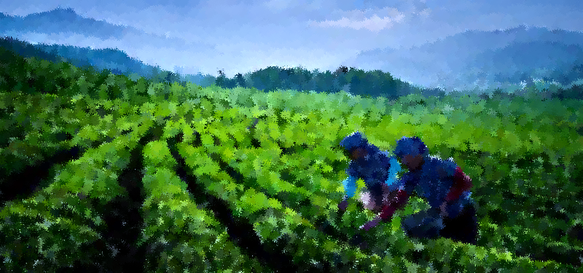
Showing the credit disparities and Modelling the determinants of Credit disbursement among Indian Regions

Slide 2
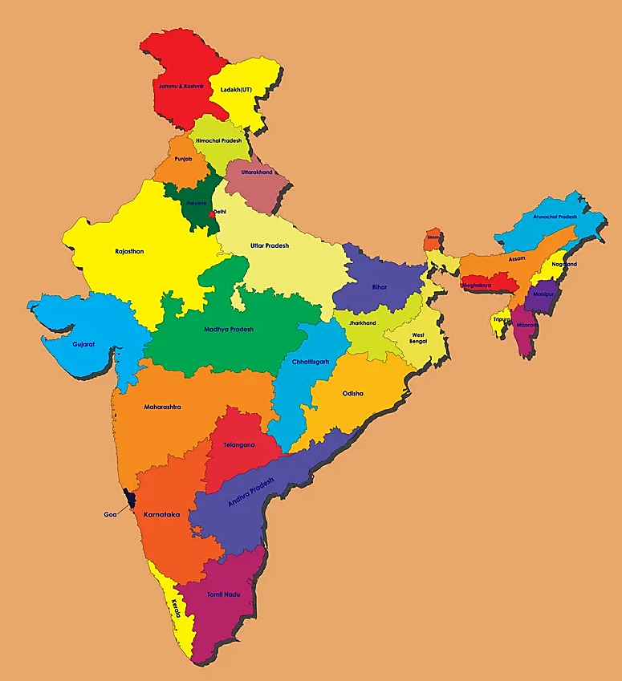
AGRICULTURE
Agriculture is an important sector in the view of its contribution to GDP and Employment for both the Central and State Governments of the country.
The food we eat is a gift of agricultural activities on which the farmers work hard to provide.
It provides us with raw material to help build the industrial sector.
India also has millions of small and marginal farmers who help the country grow ahead.
“Agriculture is the backbone of the Indian Economy” ---Mahatma Gandhi

Slide 3
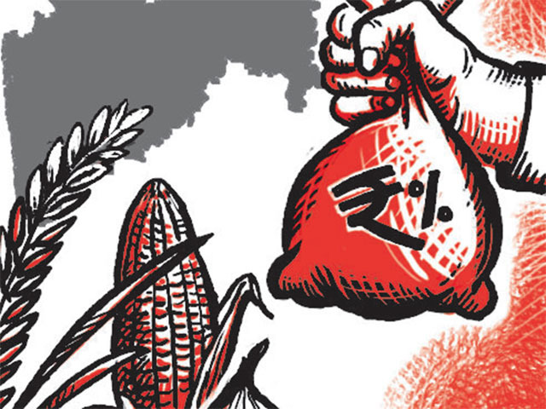
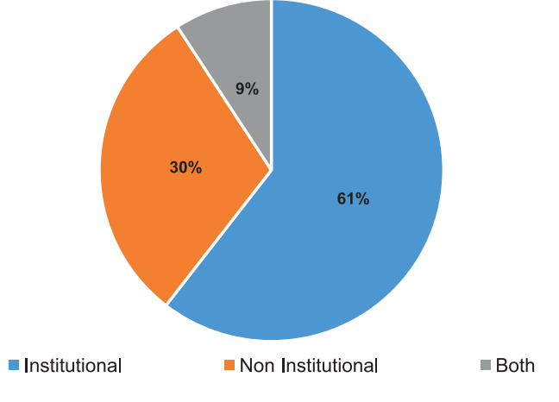
AGRICULTURE
CREDIT
Credit is an important input for farmers which helps them to buy capital, seeds, fertilizers, tools etc.
It also helps increase Agriculture production besides conducting all agricultural development programmes.
It also facilitates the adoption of new technology.
Source: RBI Report of the Internal Working group to Review Agriculture Credit 2019

Slide 4

AGRICULTURE
CREDIT

Slide 5
AGRICULTURE
CREDIT

Slide 6
AGRICULTURE
CREDIT

Slide 7

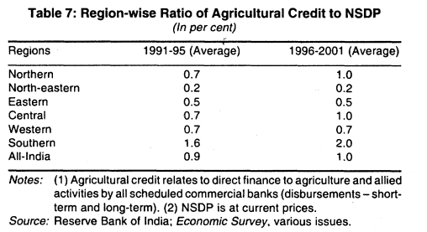
BACKGROUND
Regional Disparities exists shown in one among various papers :
Agricultural Credit in India: Status, Issues and Future Agenda Author(s): Rakesh Mohan Source: Economic and Political Weekly , Mar. 18-24, 2006
Region-wise ratio of Agricultural Credit to NSDP

Slide 8

Objective

Slide 9
Variables
Objective

Slide 10
Technique
Variables
Objective

Slide 11
Results
Technique
Objective
Variables
Objective

Slide 12
Variables
Results
Objective
Interpretation
Technique
Variables
Objective

Slide 13
Technique
Limitations
Variables
Interpretation
Results
Objective
Technique
Variables

Slide 14
Limitations
Technique
Variables
Interpretation
Results
Objective
Technique

Slide 15






Modelling

Slide 16
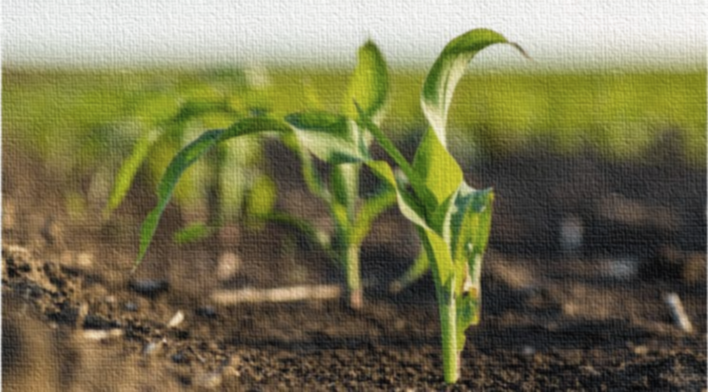
Objective
Showing the credit disparity and Modelling the determinants of Credit disbursement among Indian Regions.

Slide 17
Variables
The Variables considered here are-
Dependent variable:-
Credit disbursed (logcredit)
Independent variable:-
Number of bank branches (nob)
Number of cooperative societies (cs)
Unirrigated area (ul)
Cropping intensity (ci)
Agriculture GDP (agrigdp)

Slide 18
Sources of Variables
Credit dispersed is the dependent variable
Source: “Agricultural Credit in India: Status, Issues and Future Agenda”
Author(s): Rakesh Mohan Source: Economic and Political Weekly , Mar. 18-24, 2006
Number of bank branches-
More availability of bank branches(commercial banks RRBs, Cooperative banks), easy availability of credit.
Source: “Determinants of access to and intensity of formal credit: evidence from a survey of rural households in eastern India”
Author(s): K S Aditya , Girish K Jha , Vinay K Sonkar , Sunil Saroj , K M Singh and R K P Singh 2019

Slide 19
Sources of Variables
Number of cooperative societies: Having a cooperative society in a village will make credit availing easy.
Source: “Determinants of access to and intensity of formal credit: evidence from a survey of rural households in eastern India”
Author(s): K S Aditya , Girish K Jha , Vinay K Sonkar , Sunil Saroj , K M Singh and R K P Singh 2019.
Unirrigated Area: Farmers having Unirrigated area would be needing credit to buy irrigation facilities.
Source: “Determinants of Agricultural credit in rural India”
Author(s): Karthick V and Madheswaran 2020.

Slide 20
Sources of Variables
Agricultural GDP: If a state has higher Agricultural value added, then the state’s income from agriculture will be high hence the banks would be more willing to give the loans, thus increasing the credit dispersed (as more incomes would mean, the banks are more positive that their loans would be repaid).
Cropping intensity - More number of crops a person grows in a area, more credit he would be needing.
The aforementioned variables has been considered as per our understanding of the topic. As per our hypothesis, both the variables bear a positive relation with the dependent variable.

Slide 21

Choice of technique
We use Panel data Regression technique.
Justification provided for usage of Fixed effects model-
Our objective is to find the disparity between the amount of loan disbursed across the 6 regions in the country. As the mean of the states in a particular region remains constant and vary only across various regions, we have chosen to use the fixed effects model as it best represents the situation.
Data Sources- RBI, Ministry of Agriculture and Farmer’s Welfare (Indiastat)
Time period considered: 2004-2019
Telangana, Jharkhand and the Union territories have been excluded due to lack of data availability.

Slide 22

Results
Variables | Western | Southern | Central | Eastern | Northeast | Northern
lgdp | 1.603* | 1.814* | 1.75* | 1.85* | 1.53* | 1.57*
ul | 0.01000** | 0.01** | 0.01** | 0.01** | 0.01** | 0.002**
ci | -0.0200* | -0.009** | -0.002** | -0.008** | 0.006* | 0.44*
nob | 0.0100** | 0.42* | 0.74* | 0.01** | 0.016** | 0.02*
cs | 0.0100** | 0.001* | 0.01* | 0.001* | 0.0002** | 0.02*
const | 1 .506** | -6.925* | -4.14* | -11.15* | -5.65* | -13.001*
* significant at 5% level
** significant at 10% level

Slide 23
Modelling
WESTERN
Log Credit= 1.506 + 1.603Loggdp + 0.01ul -0.02ci + 0.01nob +0.01cs
SOUTHERN
Log credit= -6.925 +1.814loggdp+ 0.01ul - 0.009ci + 0.42nob + 0.001cs
CENTRAL
Log credit = -4.14 + 1.75loggdp + 0.01ul -0.002ci- 0.74nob+0.01cs
EASTERN
Logcredit= -11.15 + 1.85loggdp+0.01ul - 0.008ci + 0.01nob + 0.001cs
NORTH-EAST
Logcredit = -5.65+ 1.53 loggdp + 0.1ul + 0.006ci + 0.016 nob +0.0002cs
NORTH
Logcredit = -13.001 + 1.57loggodp + 0.002ul + 0.44ci + 0.021nob+0.02cs

Slide 24

Interpretation and conclusion
The intercept/constant term is different for different regions, indicating the regional disparity in loans disbursed (as per the implication in a fixed effects model).
Log GDP is positively associated with the credit disbursed.
- If a state has high income from agriculture, the banks are more optimistic that their loans would be repaid in due time.
The Unirrigated area is positively related for all regions, indicating the phenomenon where more the unirrigated land, farmers will take more loans to help themselves buy better irrigation facilities to make the land irrigated and generate higher revenues.

Slide 25

Interpretation and conclusion
Cropping intensity bears a negative relation for 4 of 6 regions, implying that if the same land is used for multiple times in a year, then the person’s income from that area of land would be more, which would then mean that he would not be needing credit as much compared to a person who crops only once a year, thus wanting higher credit (as his income is less, he would take a loan to increase his production for the one time he produces) In addition, producing more times would reduce the fertility, thus the marginal productivity of the land would fall and the farmer would not be willing to take the loan.

Slide 26

Interpretation and conclusion
For all regions, the amount of bank branches positivity effects the amount of credit. More banks would mean, more credit.
Number of cooperative societies positively effects the amount of credit, that would mean, more number of cooperative societies, more amount of credit dispersed

Slide 27
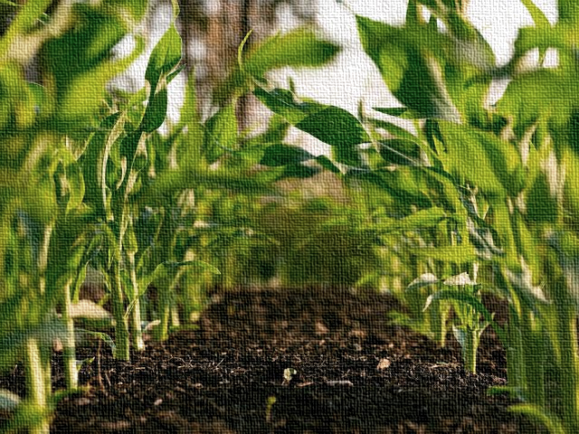
Limitations
Variables like education, farmer awareness could not be taken due to data constraints
Agriculture NSDP has double causality.
Proportion of small and marginal farmers, although important, could not be included due to non-availability of yearly data.

Slide 28

THANK YOU

